Slide 1
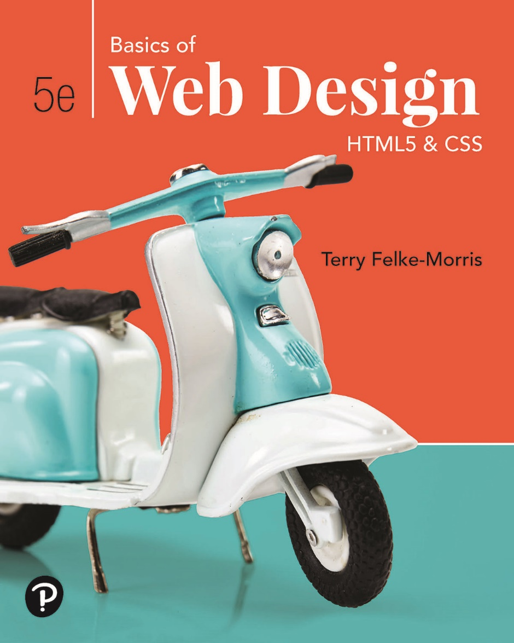
Basics of Web Design
Fifth Edition
Chapter 2
H T M L Basics Key Concepts
Slide in this Presentation Contain Hyperlinks. JAWS users should be able to get a list of links by using INSERT+F7
Copyright © 2019 Pearson Education, Inc. All Rights Reserved
Notes:
If this PowerPoint presentation contains mathematical equations, you may need to check that your computer has the following installed:
1) Math Type Plugin
2) Math Player (free versions available)
3) NVDA Reader (free versions available)

Slide 2
Learning Outcomes
Describe the anatomy of a web page
Format the body of a web page with block-level elements including headings, paragraphs, lists, and blockquotes
Configure the text on a web page with inline elements
Configure text with phrase elements
Configure special entity characters, line breaks, and horizontal rules
Configure a web page using new H T M L 5 header, nav, main, and footer elements
Use the anchor element to link from page to page
Configure absolute, relative, and e-mail hyperlinks
Test a web page for valid H T M L syntax

Slide 3
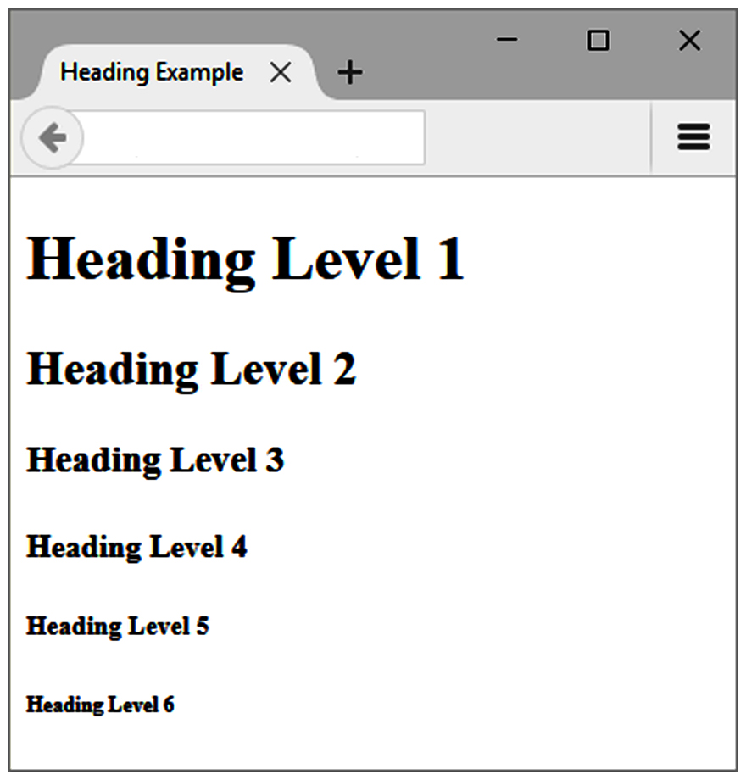
The Heading Element
<h1>Heading Level 1</h1>
<h2>Heading Level 2</h2>
<h3>Heading Level 3</h3>
<h4>Heading Level 4</h4>
<h5>Heading Level 5</h5>
<h6>Heading Level 6</h6>

Slide 4
The Paragraph Element <p> tag
Paragraph element
<p> …paragraph goes here… </p>
Groups sentences and sections of text together.
Configures empty space above and below the paragraph

Slide 5
The Line Break Element <br> tag
Line Break element
Stand-alone tag
Called a void element in H T M L 5
…text goes here <br> This starts on a new line….
Causes the next element or text to display on a new line

Slide 6
The Horizontal Rule Element <hr> tag
Horizontal Rule element
void element
<hr>
Configures a horizontal line on the page
In H T M L 5, it should be used to indicate a thematic break at the paragraph level

Slide 7
The Blockquote Element <blockquote>
Blockquote element
Indents a block of text for special emphasis
<blockquote>
…text goes here…
</blockquote>

Slide 8
Phrase Elements
Indicate the context and meaning of the text
Display inline with the text
Common Phrase Elements
<b></b>
Text is displayed in bold font
<strong></strong>
Text has strong importance and is displayed in bold
<i></i>
Text is displayed in italic font
<em></em>
Text has emphasis and is displayed in italic font

Slide 9
Proper Nesting
CODE:
<p><i>Call for a free quote for your web development needs: <strong>888.555.5555 </strong></i></p>
BROWSER DISPLAY:
Call for a free quote for your web development needs: 888.555.5555

Slide 10
H T M L List Basics
Unordered List
Description List (X H T M L Definition List)
Ordered List

Slide 11
Unordered List
Displays information with bullet points
Unordered List Element
<ul> Contains the unordered list
List Item Element
<li> Contains an item in the list

Slide 12
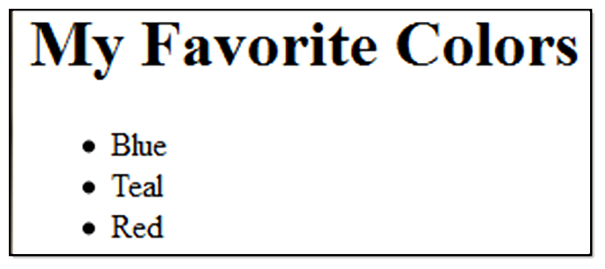
Unordered List Example
<h1>My Favorite Colors</h1>
<ul>
<li>Blue</li>
<li>Teal</li>
<li>Read</li>
</ul>

Slide 13
Ordered List
Conveys information in an ordered fashion
Ordered List Element
<ol> Contains the ordered list
type attribute determines numbering scheme of list
default is numerals
List Item Element
<li> Contains an item in the list

Slide 14
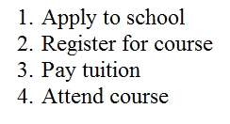
Ordered List Example
<ol>
<li>Apply to school</li>
<li>Register for course</li>
<li>Pay tuition</li>
<li>Attend course</li>
</ol>

Slide 15
Description List
Uses:
Display a list of terms and descriptions
Display a list of F A Q and answers
The Description List element
<dl> Contains the definition list
The dt Element
<dt> Contains a term or name
The dd Element
<dd> Contains a definition or description Indents the text

Slide 16
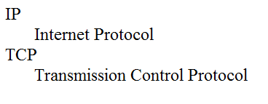
Description List Example
<dl>
<dt>I P</dt>
<dd>Internet Protocol</dd>
<dt>T C P</dt>
<dd>Transmission Control Protocol</dd>
</dl>

Slide 17
Special Entity Characters
Display special characters such as quotes, copyright symbol, etc.
Character | Code
© | &copy;
< | &lt;
> | &gt;
& | &amp;
blank | &nbsp;

Slide 18
The div element <div>
Purpose:
Configure a specially formatted division or area of a web page
Block display with empty space above and below the div
Can contain other block display and inline display elements

Slide 19
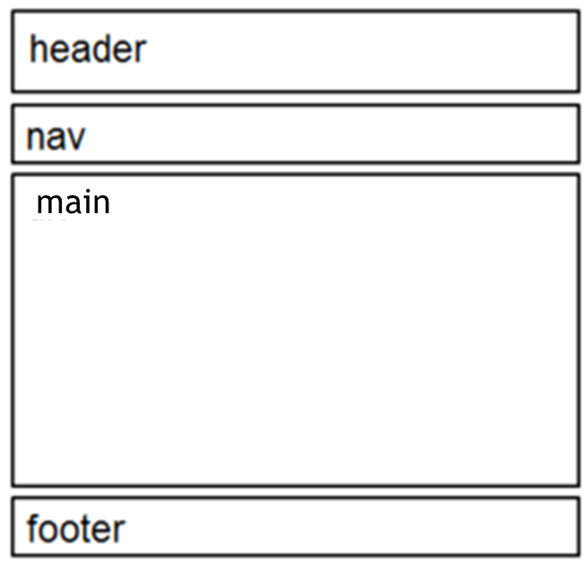
Structural Elements
Header Element
<header></header> Contains the headings
Nav Element
<nav></nav> Contains the main navigation
Main Element
<main></main> Contains the main content
Footer Element
<footer></footer> Contains the footer

Slide 20
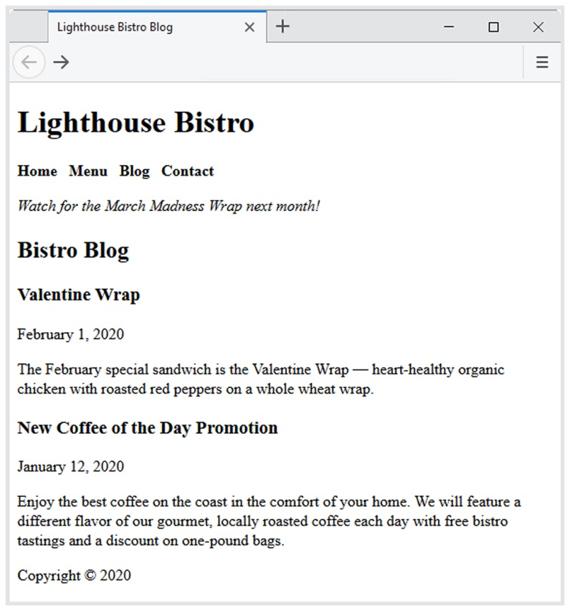
More Structural Elements
Section Element
indicates a portion or “section” of a document, like a chapter or topic
Article Element
indicates an independent entry, like a blog posting, that can stand on its own
Aside Element
indicates a sidebar or other tangential content
Time Element
represents a date or time

Slide 21
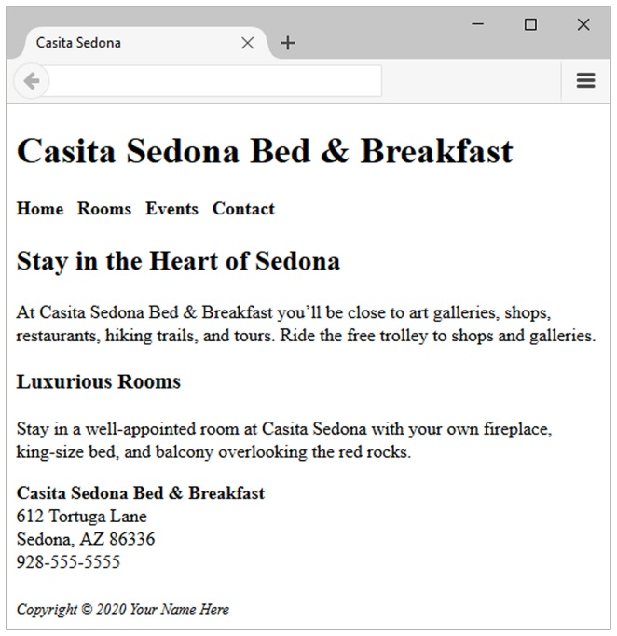
H T M L 5 Structural Elements
Example:
<body>
<header> document headings go here </header>
<nav> main navigation goes here </nav>
<main> main content goes here </main>
<footer> document footer information goes here </footer>
</body>

Slide 22
The Anchor Element <a>
The anchor element
Inline display element
Specifies a hyperlink reference (href) to a file
Text between the <a> and </a> is displayed on the web page
<a href="contact.html">Contact Us</a>
href Attribute
Indicates the file name or U R L Web page document, photo, pdf, etc.

Slide 23
More on Hyperlinks
Absolute link
Link to other websites
<a href="http://yahoo.com">Yahoo</a>
Relative link
Link to pages on your own site
Relative to the current page
<a href="index.html">Home</a>

Slide 24
Opening a Link in a New Browser Window
The target attribute on the anchor element opens a link in a new browser window or new browser tab.
<a href="http://yahoo.com" target="_blank">Yahoo!</a>

Slide 25
Email Hyperlinks
Automatically launch the default mail program configured for the browser
If no browser default is configured, a dialog box is displayed
<a href="mailto:me@terrymorris.net">me@terrymorris.net</a>

Slide 26
Writing Valid H T M L
Check your code for syntax errors
Benefit:
Valid code → more consistent browser display
W 3 C H T M L Validation Tool
http://validator.w3.org
Additional H T M L 5 Validation Tool
http://html5.validator.nu

Slide 27
Summary
This chapter provided an introduction to H T M L.
H T M L elements used for inline and block display formatting were introduced.
You will use these skills over and over again as you create web pages.

Slide 28

Copyright
This work is protected by United States copyright laws and is provided solely for the use of instructors in teaching their courses and assessing student learning. Dissemination or sale of any part of this work (including on the World Wide Web) will destroy the integrity of the work and is not permitted. The work and materials from it should never be made available to students except by instructors using the accompanying text in their classes. All recipients of this work are expected to abide by these restrictions and to honor the intended pedagogical purposes and the needs of other instructors who rely on these materials.

